Slide 1
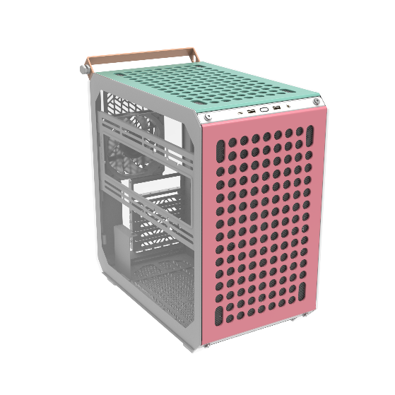
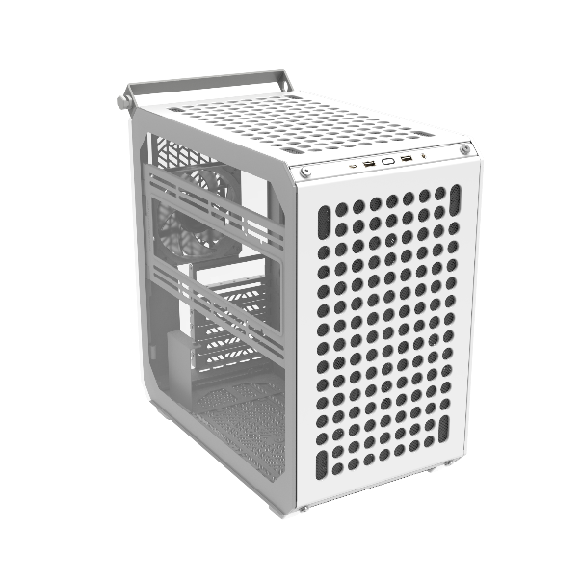
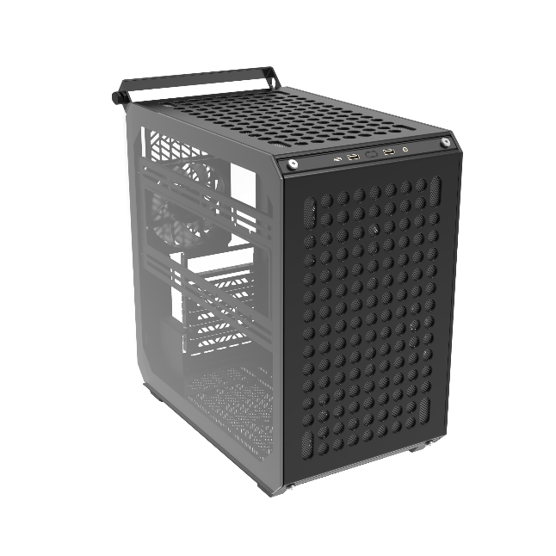
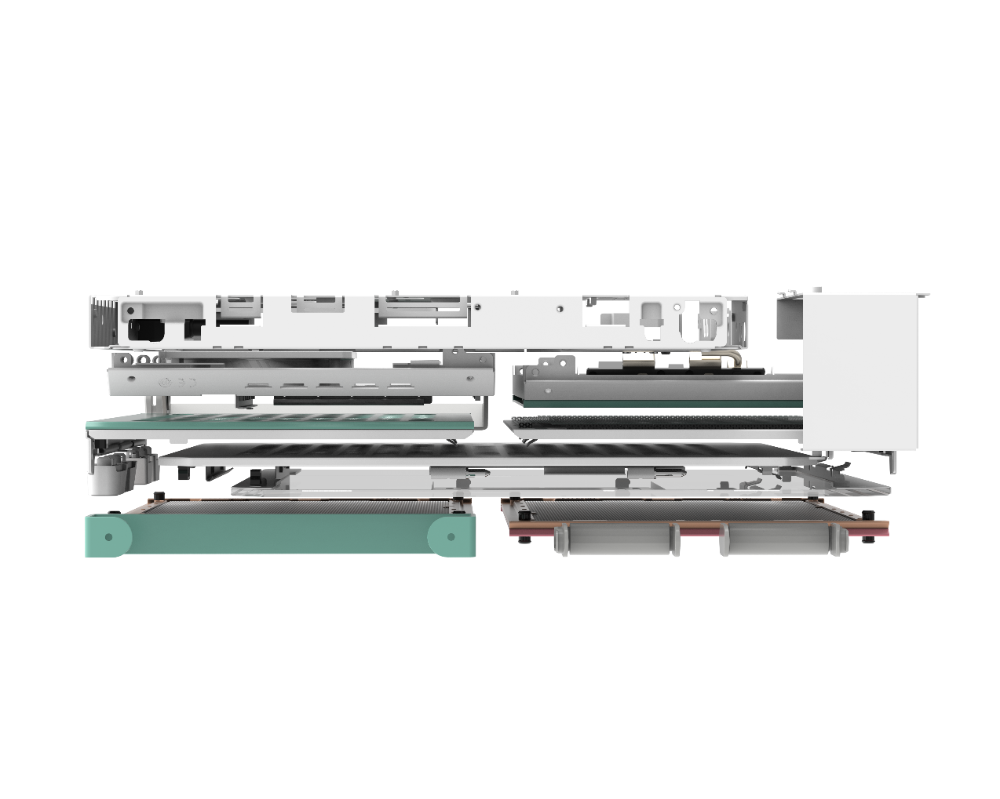
Create It Your Way
Introducing the all-new QUBE 500, a highly customizable flat pack case from Cooler Master that allows you to emphasize your own personal style and creativity.
The QUBE 500 comes flat packed and disassembled, designed to offer a fun, easy, and satisfying build experience that starts from scratch. Plus, The QUBE 500's innovative packaging greatly reduces its transportation carbon footprint and overall environmental costs.
From dual 280mm radiator slots and 8 fan locations to EATX support, this case has all you need for a modern build, All at a super compact size of just 33L.
Due to the removable nature of the flat pack design, its super easy to open any panel, plug or unplug cables, and close it again without issue. This level of modularity is also great for customization, allowing you to adjust the case however you want to.
We intend to create a change in the industry with the QUBE 500 by giving users an eco-friendly case solution that is easier to build, has all the specs you could want, and is highly customizable.
QUBE 500 FLATPACK
DIY for everyone
An efficient and eco-friendly flat pack design allows for a fun and flexible build experience that both beginners and long-time builders can enjoy.
Full-sized specs, pint-sized body
Despite its compact size at 33L, the QUBE 500 can house almost anything you would expect from a larger case, from EATX Motherboards and the latest GPUs to dual 280mm radiators.
Build as you unbox
From the moment you open the box, the build begins with fun and easy step-by-step instructions.
Color your way
Fully express yourself with the multi-color Macaron edition. It includes two sets of extra panels, an extra handlebar and two accessory hooks. Because all the panels are modular you can create 3 different color cases or mix and match.
Highly customizable
An unprecedented level of customizability allows full creative expression.
Fully modular
Features modular panels that simplify and streamline the usual case prep process. Every panel is separately removable for easy maintenance.

Slide 2
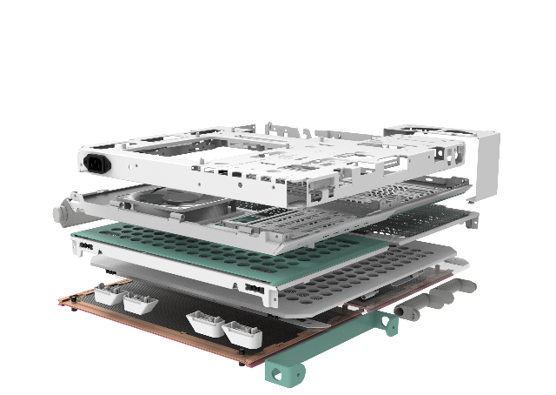
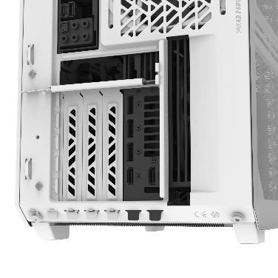
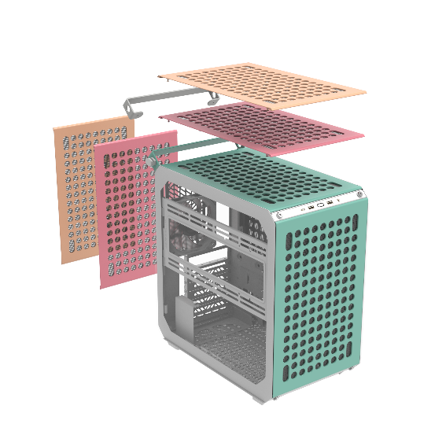
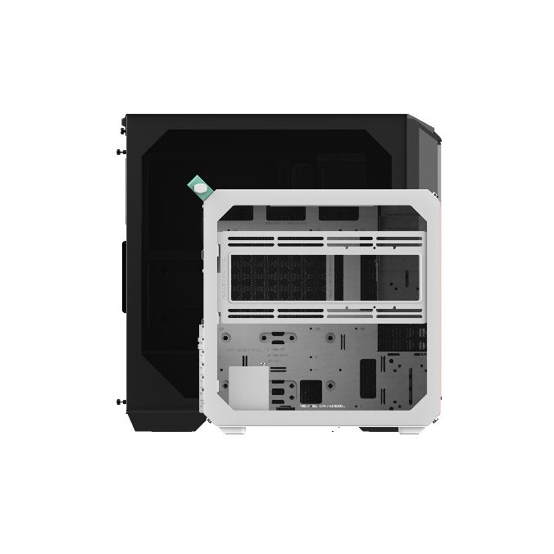
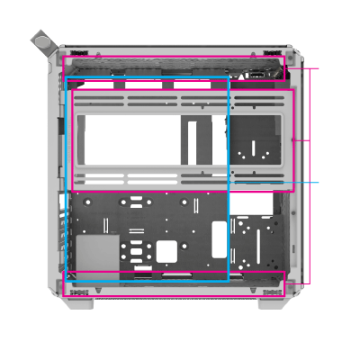
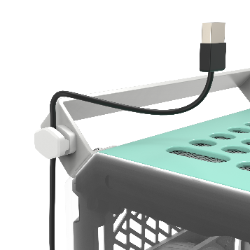
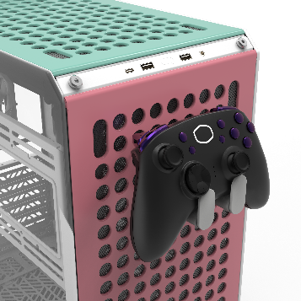
Flat pack assembly
Built-in vertical GPU mount
Besides the clear carbon footprint benefits flat pack assembly, we believe flat packing will provide a more fun and satisfying building experience that really focuses on doing it yourself. You wouldn’t want your model kit to be prebuilt, right?
Vertically mount your GPU with the included bracket. You can even adjust the distance from the side panel to maintain good airflow.
Modular design
One of the most compact ATX cases
Modularity permeates the whole design of the QUBE 500. The outer panels can be exchanged or placed at the bottom of the case, the handlebar can be mounted on any of the corners, and you can even use the case in mirror or testbench mode.
The QUBE 500 is a highly compact ATX case at 33L. However, it include all the specs and features you’ve come to expect in larger cases.
280mm
Radiators
E-ATX
Up to 280mm
Great specs
Customize and personalize
Despite its small size the QUBE 500 can house up to an EATX motherboard, two 280mm radiators, up to 8 120mm fans, and is compatible with latest GPUs.
The GEM mini cable manager and accessory hook (macaron edition only) will allow will allow you to customize the QUBE 500 to your liking, but don’t stop there. Really let your creativity loose with 3D-printed, community-driven designs!

Slide 3
Product Name |  | QUBE 500 Flatpack | QUBE 500 Flatpack White | QUBE 500 Flatpack Macaron Edition
Product Number |  | Q500-KGNN-S00 | Q500-WGNN-S00 | Q500-DGNN-S00
Exterior Color |  | Black | White | 3x set: Mint, Pink, Cream
Materials | Exterior | Steel, Plastic, TG
 | Left Side Panel | Grey TG + Steel
Dimensions (L x W x H) | Incl. Protrusions | 406 x 231 x 415mm
 | excl. Protrusions | 380 x 231 x 381mm
Volume (Liters Excl. Protrusions) |  | 33.44 L
Motherboard Support |  | ITX / Micro ATX / ATX / E-ATX (Width up to 296mm w/ SFX PSU, up to 273 w/ ATX PSU)
Expansion Slots |  | 7
Drive Bays | 5.25“ ODD | N/A
 | 3.5” HDD | Max. 4x 3.5” HDD
 | 2.5” SSD | Max. 3x 2.5” SSD
I/O Panel | USB Ports | 2x USB 3.2 Gen1 Type A, 1x USB 3.2 Gen2 x 2 Type C
 | Audio In / Out | 3.5mm Combo x 1
Pre-installed Fan(s) | Front | N/A
 | Top | N/A
 | Rear | 120mm x 1 (1800 rpm) SF Black PWM | 120mm x 1 (1800 rpm) SF White PWM | 120mm x 1 (1800 rpm) SF ARGB White PWM
Fan Support | Front | 120/140mm x 1 (x2 if PSU is mounted in bottom)
 | Top | 120/140mm x 2
 | Rear | 120mm x 1
 | Bottom | 120/140mm x 2
 | Left side | 120/140mm x 2
Radiator Support | Front | 120/140 mm (240/280mm w/ PSU in bottom)
 | Top | 120/140/240/280mm (280mm can be used within 53mm thickness)
 | Rear | 120mm
 | Bottom | 120/140/240/280mm
 | Left side | 120/140/240/280mm
Clearances | CPU Cooler | 164mm~172mm (Remove the water cooling bracket)
 | Power Supply (length) | 173mm to first GPU slot, 216 maximum space (w/o cable management space) 332mm space mounted in bottom (w/o cable management space)
 | Graphics Card | 365mm
Cable Routing space | Behind MB Tray | 29~32mm
Handle |  | Black x 1 | Grey x 1 | Mint x 1, Grey x 1
Gem Mini |  | Black x 1 | Grey x 1 | Grey x 1
Accessory Hook |  | N/A |  | x 2
Dust Filters |  | Front, Top, Bottom, Right side
Power Supply Support |  | SFX / SFX-L / ATX
Warranty |  | 2 Years
EAN code | Q500-KGNN-S00： 4719512140383 6928968318583 (CN) Q500-WGNN-S00：4719512140390 6928968318590 (CN) Q500-DGNN-S00： 4719512140406 6928968318606 (CN)
UPC code | Q500-KGNN-S00：884102112706 Q500-WGNN-S00：884102112713 Q500-DGNN-S00：884102112720
Net weight (KG) | Q500-KGNN-S00/Q500-WGNN-S00：7.80 kg Q500-DGNN-S00：10.00 kg
Gross weight (KG) | Q500-KGNN-S00/Q500-WGNN-S00：9.42 kg Q500-DGNN-S00：11.23 kg
Carton dimension (L x W x H)mm | Q500-KGNN-S00/Q500-WGNN-S00：513 x 453 x 146mm Q500-DGNN-S00：513 x 453 x 175mm
Q500-KGNN-S00/Q500-WGNN-S00
Cont. | W/ Pallet | Carton/ Pallet | W/O Pallet
20’ | 624 | 52 | 770
40’ | 1248 | 52 | 1610
40 HQ | 1440 | 60 | 1955
Q500-DGNN-S00
Cont. | W/ Pallet | Carton/ Pallet | W/O Pallet
20’ | 528 | 44 | 660
40’ | 1056 | 44 | 1380
40 HQ | 1152 | 48 | 1610

